Slide 1
SAS Optimization Challenge
Team: Miss YSL
Notes:
we are team Miss YSL, and we are gonna present our solution to SAS Optimization Challenge

Slide 2





Our Team
Mu-Hua Hsu.
Yi-Hsuan Hsu
Su-Tien Lee.
Li-Ci Chuang
Notes:
I am Li-Ci, and here is our team member

Slide 3
Agenda
1. Project Introduction
2. Project Flow
3. Conclusion
Notes:
we have 3 components in today’s presentation

Slide 4
01
Project Introduction
Notes:
The first one is project introduction

Slide 5
Project Introduction
Client
Project Goal
Methodology
XYZ Corporation
Forecast Demand,
Minimize Total Cost
Time-Series Forecast
Optimization Model
Notes:
Our client is XYZ Corporation
Our project goal is to forecast the water usage demand, and to minimize the total cost
To reach our project goal, we use time series forecast and optimization model as our methodology

Slide 6
02
Project Flow

Slide 7
Project Flow
Objective 1
Objective 2
Forecast the weekly demand for the next four weeks.
Build optimization model to minimize total cost with specified constraint
Notes:
Our Project flow includes two objectives.

Slide 8
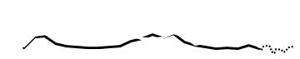
Objective 1
Forecast of water usage for different use in each future four weeks.
Cooling
Main
Notes:
The first one is to forecast the future water usage for four weeks

Slide 9
Time Series Forecast
SAS: Additive Season | Minitab | Python: ARIMA
SAS: Additive Winter | Excel | Python: SARIMAX
SAS: Random Walk |  | Python: Holt-Winters
… | … | …
Notes:
we have tried different tools and models to do that, including SAS, Minitab, Excel and also Python

Slide 10
Time Series Forecast
SAS: Additive Season | Minitab | Python: ARIMA
SAS: Additive Winter | Excel | Python: SARIMAX
SAS: Random Walk |  | Python: Holt-Winters
… | … | …
Notes:
Finally, we choose SAS as our tool, and the model is Additive Winter and Random Work

Slide 11
Time Series Forecast
35,065
30,727
19,658
Cooling
17,658
2022/1/9 - 15
2022/1/16 - 22
2022/1/23 - 29
2022/1/30 - 2/5
41,414
42,795
Main
35,339
35,273
Notes:
So the final number is like this. For Cooling usage: obvious increasing trend
however, for Main usage: it is more stable but still with slight increase

Slide 12
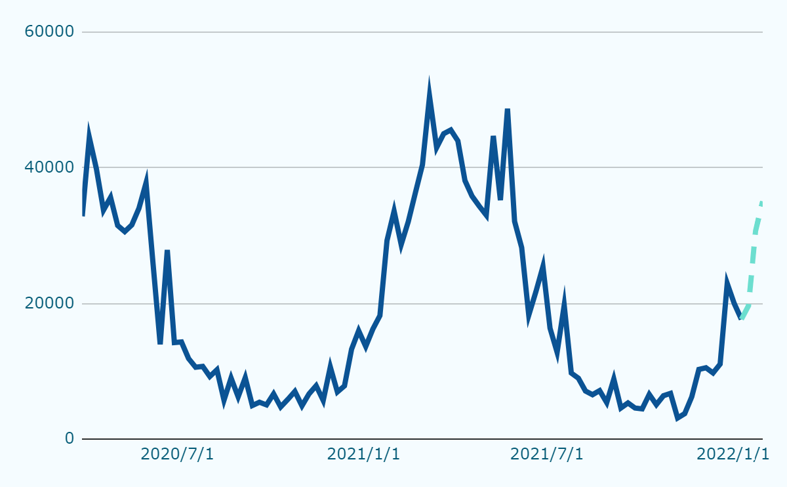
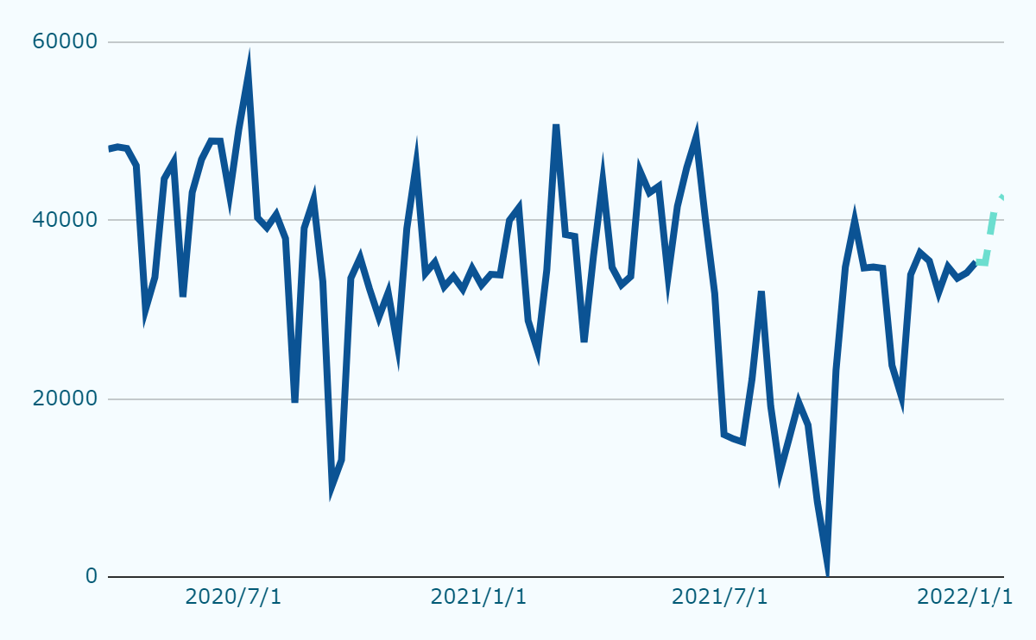
Time Series Forecast
Cooling
Main
Historical
Forecast
Historical
Forecast
Notes:
The trend is more clear with these two visuals

Slide 13
Objective 2
Build optimization model to minimize total cost with specified constraint.
Total Water Cost = Cost of Water Co. + Cost of Water Storage Tank
Contract1 unit price
= $0.12 per gallon
Contract2 unit price = $0.18 per gallon
Purchase
Amount?
Notes:
let’s jump into Our objective 2: minimize the total water usage cost from different sources

Slide 14
Model Building Steps
01
02
03
04
Identify model objectives and constraints
Turn into mathematical formulas.
Set up on SAS
Run the solution on SAS
Notes:
and we followed 4 steps to build our model

Slide 15
Identify Model
Objectives and Constraints
Objectives
Constraints
Minimum purchase amount from The Water Co., based on the contract the company would signed.
Ending water tank storage of each week >= 30,000 gallons.
At least 25% of total water usage should come from the water storage tank.
Amount sourced from purchase and water storage tank >= Forecast.
Minimize
The overall
purchase cost + treatment cost
Notes:
treatment cost
we have identified 4 constraint according to our client requests

Slide 16


2. Turn into Mathematical Formula
Demonstrated
by week 1
Given
x = Week1 water usage sourced from The Water Co.
y = Week1 water usage sourced from Water Storage Tank.
The overall usage cost from purchase the two sources.
Overall water usage cost in week1
= x * Week1 cost of purchase per gallon +
y * Week1 treatment cost per gallon
Objective
Notes:
to construct the optimization model, we need to turn → mathematical formula
we define x, y to represent different water usage sources

Slide 17
2. Turn into Mathematical Formula
Demonstrated
by week 1
Overall water usage cost in week1
= x * Week1 cost of purchase per gallon +
y * Week1 treatment cost per gallon
= x * Week1y cost of purchase per gallon +
y * 0.18
Note: Week 1 purchase cost is 0.15 or 0.12, depending on the contract selected.
Objective
Notes:
as we have the 2 variables, we can now build the objective formula

Slide 18
2. Turn into Mathematical Formula
Demonstrated
by week 1
Minimum purchase amount from The Water Co., based on the contract the company would signed.
x >=25,000
or
x >=35,000
Constraint
01
Notes:
depend on the contract we signed, we need to subject to the different specified minimum purchase amount

Slide 19
2. Turn into Mathematical Formula
Demonstrated
by week 1
Ending water tank storage of each week >= 30,000 gallons.
(Beginning + Percipitation - Weekly usage from water tank >=30,000)
62,500 + 12,000 – y >=30,000
Constraint
02
Notes:
according to the company policy, the final level of water tank storage need to be larger than 30,000

Slide 20
2. Turn into Mathematical Formula
Demonstrated
by week 1
At least 25% of total water usage should come from the water storage tank.
y >= (x+y)*0.25
Constraint
03
Notes:
another constraint is the water usage from water storage tanks should not be less than 25% of total usage

Slide 21
2. Turn into Mathematical Formula
Demonstrated
by week 1
Amount sourced from purchase and water storage tank >= Forecast.
x+y >= Forecast total demand for week 1
Constraint
04
Notes:
Finally, The total water usage amount from the two sources should greater than the forecast

Slide 22
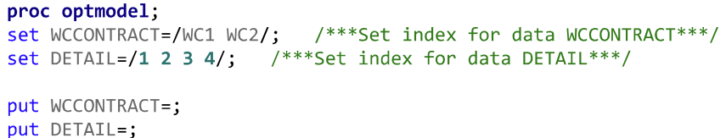
3. Set up on SAS
index
parameters
variables
Notes:
Set contracts and weeks as the model index

Slide 23
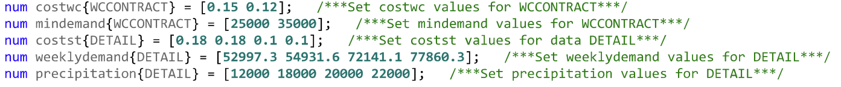
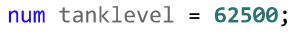
3. Set up on SAS
index
parameters
variables
Notes:
Declare model parameters on SAS

Slide 24
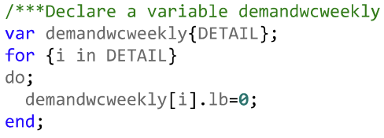
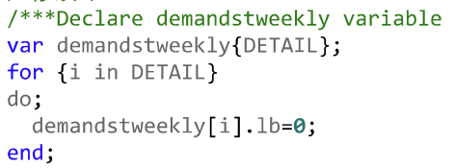
3. Set up on SAS
index
parameters
variables
Notes:
Declare variables for weekly demand from the two sources.

Slide 25
3. Set up on SAS
index
parameters
variables
Binary
Variable
Unit
purchase
cost
Minimum
purchase
amount
Notes:
Declare variables for weekly demand from the two sources.

Slide 26
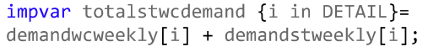
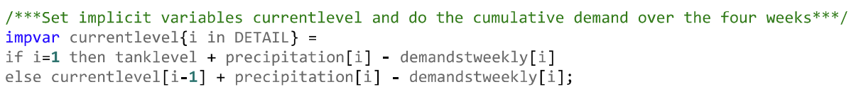
3. Set up on SAS
index
parameters
variables
Total
weekly demand
Total weekly
cost
Ending
inventory

Slide 27
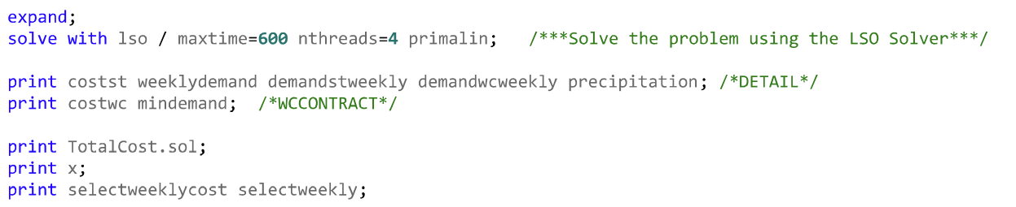
4. Run the solution on SAS
solve
output
Notes:
Solve the optimization model on SAS

Slide 28
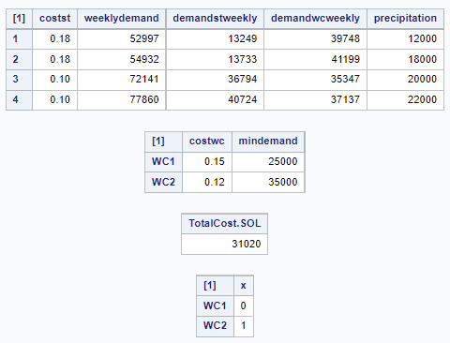
4. Run the solution on SAS
solve
output
Notes:
Solve the optimization model on SAS

Slide 29
Know More About...
What is “Contract selection influence” on the overall cost and demand from the two sources?

Slide 30
Know More About...
What is “Contract selection influence” on the overall cost and demand from the two sources?
An alternative set!
Notes:
We also ask the question, how would the contract selection influence our overall cost and demand allocation

Slide 31
4. Run the solution on SAS_ALTERNATIVE SET
solve
output
Notes:
We set an alternative set to answer this question

Slide 32
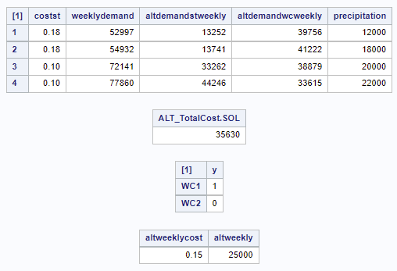
4. Run the solution on SAS_ALTERNATIVE SET
solve
output
Notes:
the output showed that the total cost is now 35,630 with different allocation of water usage

Slide 33
03
Conclusion

Slide 34
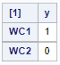
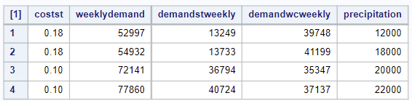
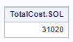
Our Suggestions
Sign Contract 2 to optimize the total cost.
$0.12 per gallons
minimum demand 35,000 per week
Detail
Notes:
After running this model, we will recommend our client to sign contract2 to optimize their cost

Slide 35
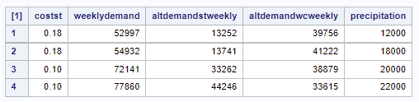
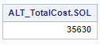
Our Suggestions
2. Select contract 2 will save the company $4,610 at the end of the four weeks.
(* $35,630 – $31,020 = $4,610)
Detail
Notes:
by doing that, it will save them about 46 hundred!

Slide 36
Thank you!

